Slide 1
Python Installation

Slide 2
Python Installation
Download the latest version of Python.
Run the installer file and follow the steps to install Python During the install process, check Add Python to environment variables. This will add Python to environment variables, and you can run Python from any part of the computer.

Slide 3
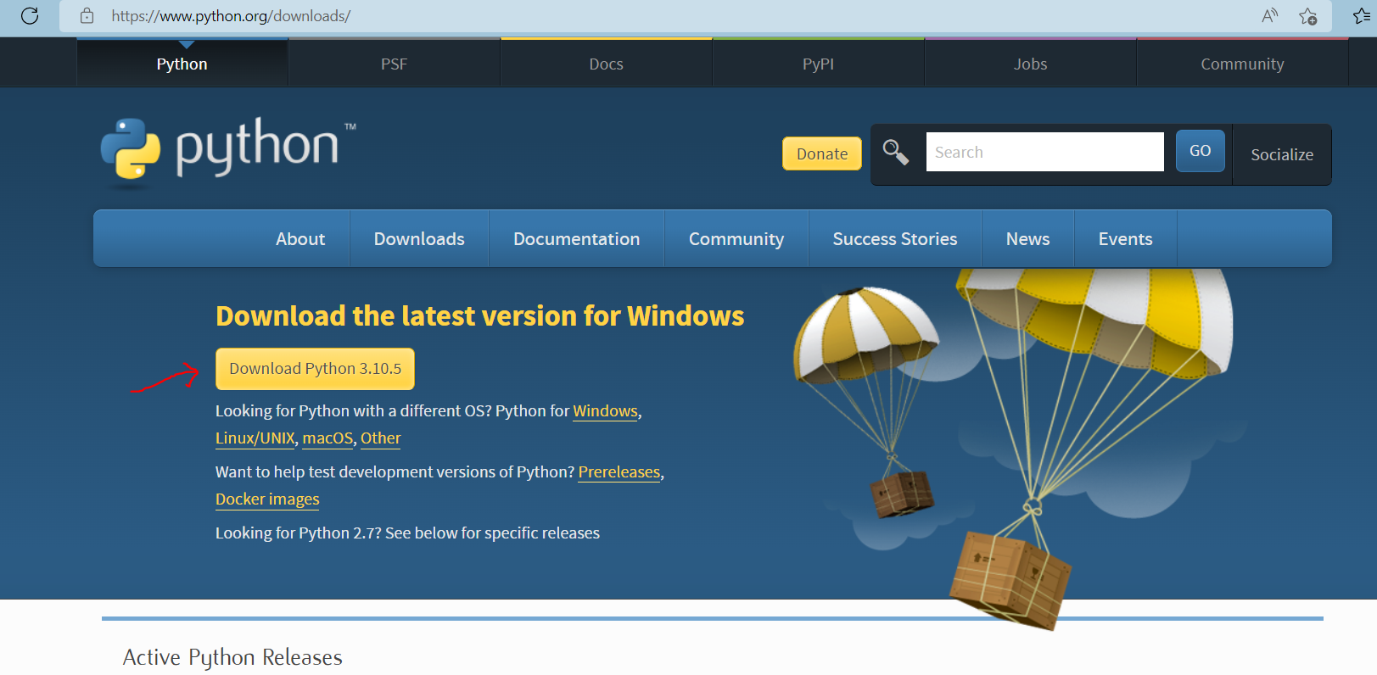
Click on Download Python | Python.org
Download the “ Python 3.10.5” version as shown below.

Slide 4
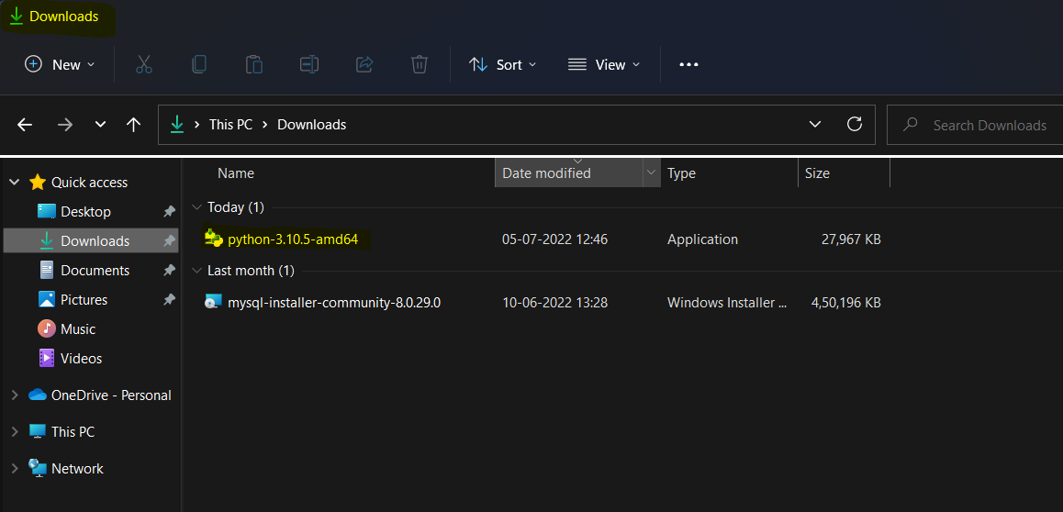
Go to Downloads and double click on python-3.10.5-amd64

Slide 5
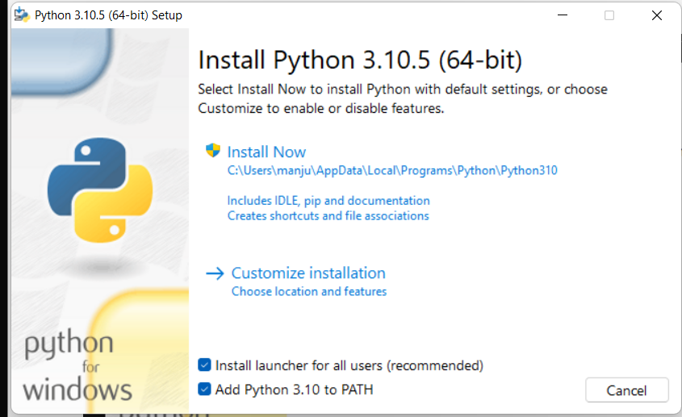

Slide 6
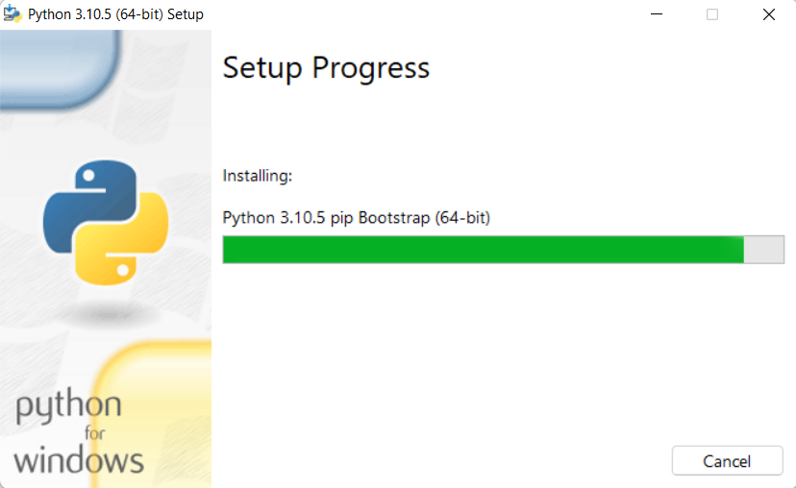
It will take few mins to complete the installation set up.

Slide 7
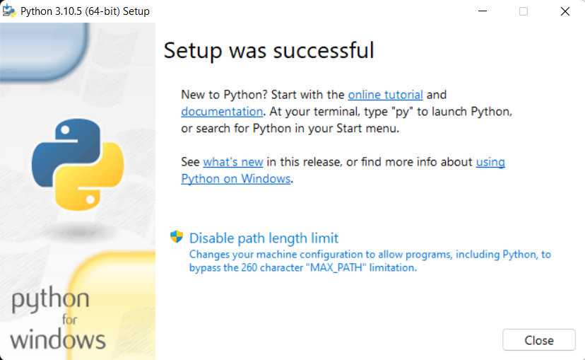

Slide 8
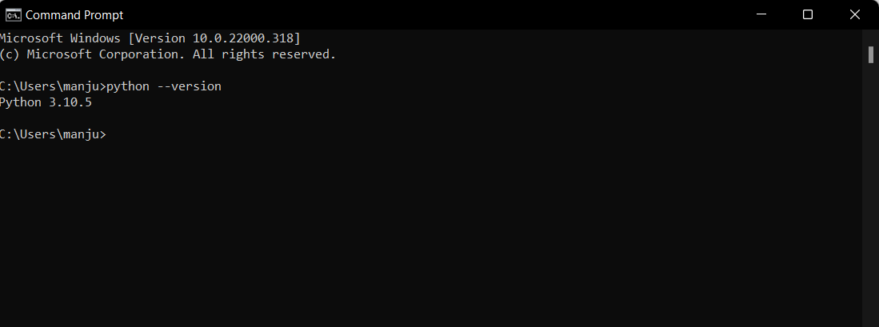
Go to Command Prompt and type → python --version

Slide 9
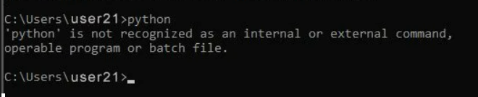
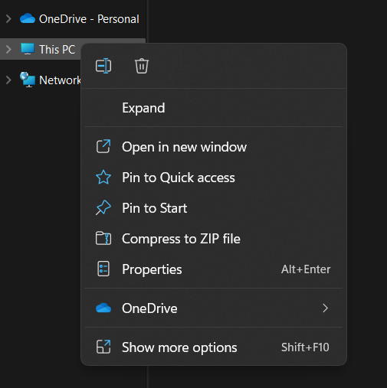
If python is not recognized as shown below, environment variables need to be set up.
In your system go to “MyComputer” or “This PC”, right click on it and click on properties.

Slide 10
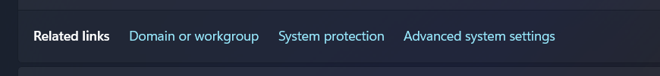
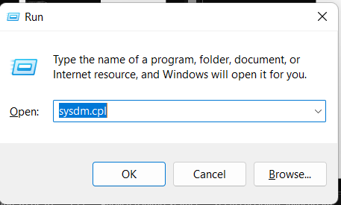
Click on ‘Advance System settings”
Or you can directly open “Advance system settings”
Press Windows + R keys together, type the command “sysdm. cpl” in the Run dialog box and press Enter.

Slide 11
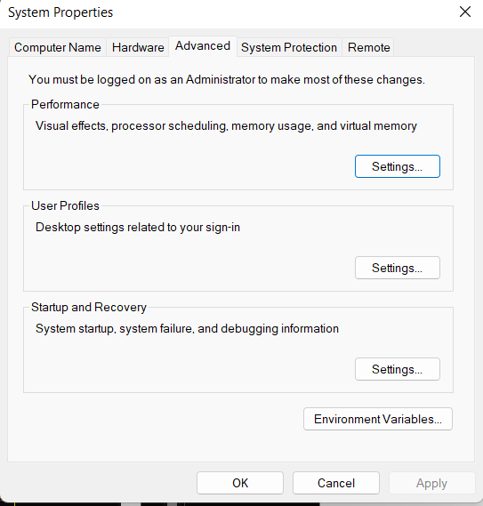

Slide 12
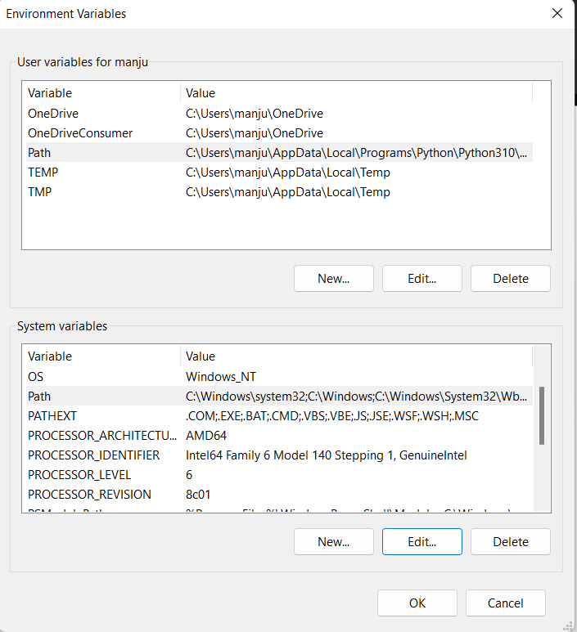
In User variables
Select path variable and add python path and also python scripts.
In System variables
Select path variable and add python path .

Slide 13
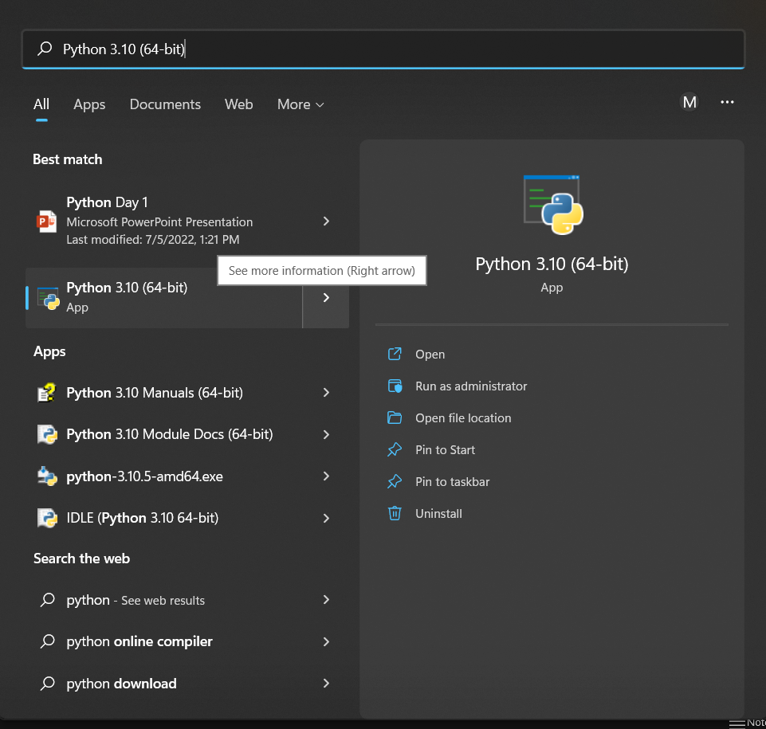
How to select python path →
Go to Windows search and type python 3.10 click on right arrow and select open file location

Slide 14
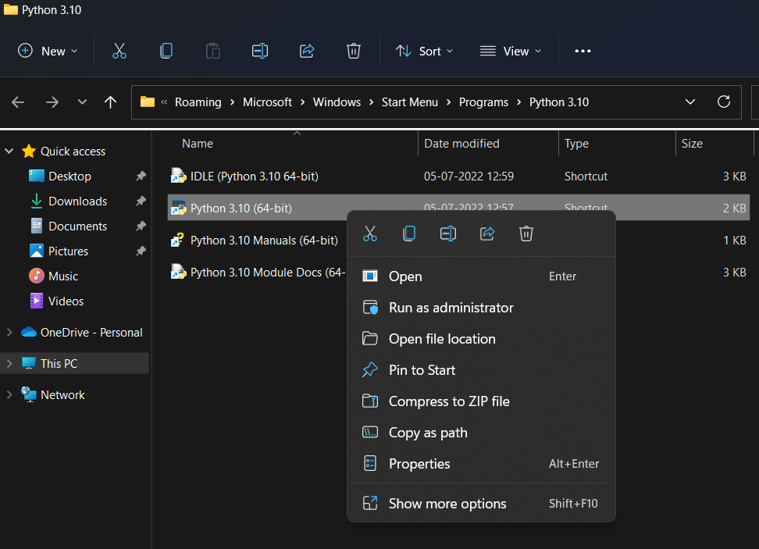
It will open file location of short cut file and select “Python 3.10(64 bit)” right click on it , click on “open file location”.

Slide 15
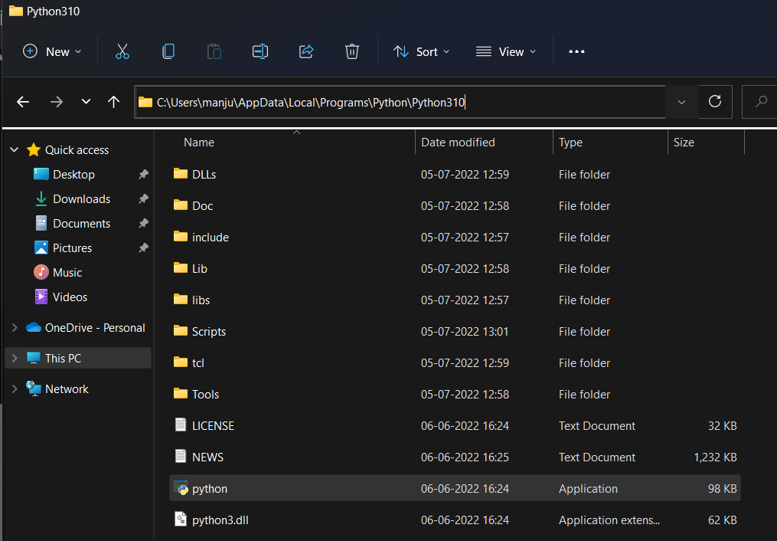
It will open a python location path, select or copy this path.
Python path → C:\Users\manju\AppData\Local\Programs\Python\Python310

Slide 16
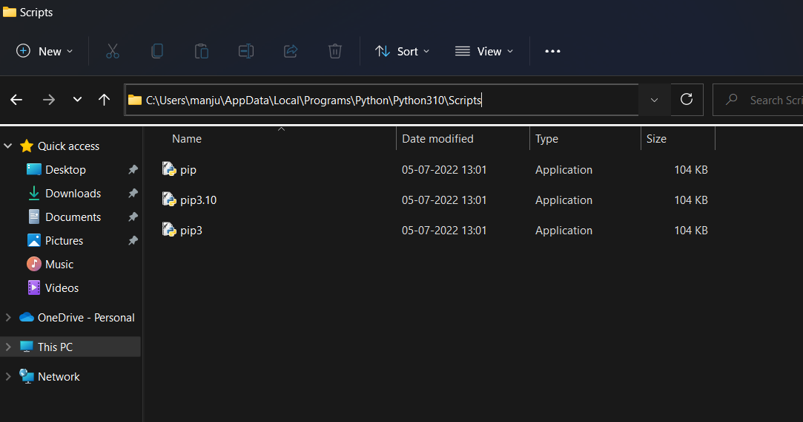
Python Scripts path → C:\Users\manju\AppData\Local\Programs\Python\Python310\Scripts

Slide 17
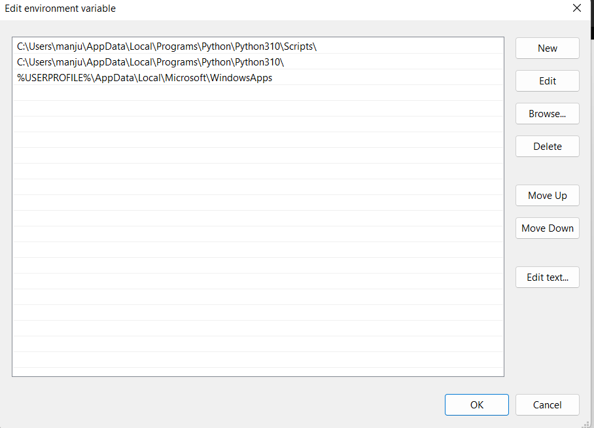
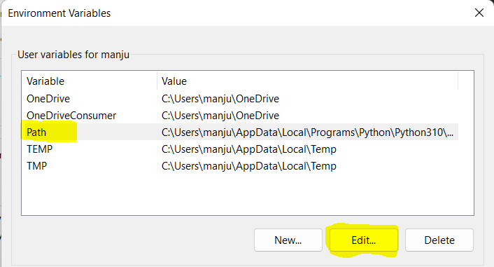
Add python and python scripts path and click ok

Slide 18
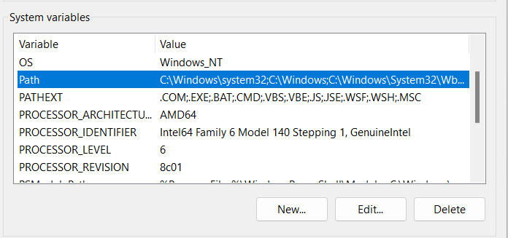
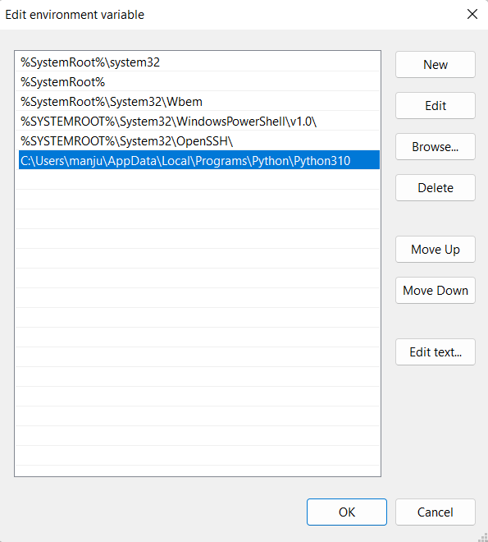
Select “Path” and click on Edit then add python path click ok

Slide 19
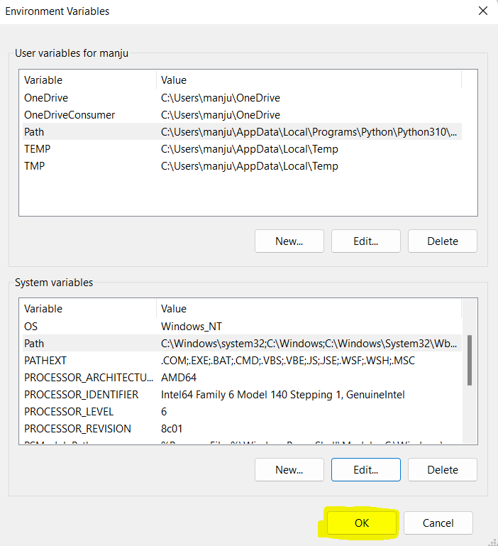
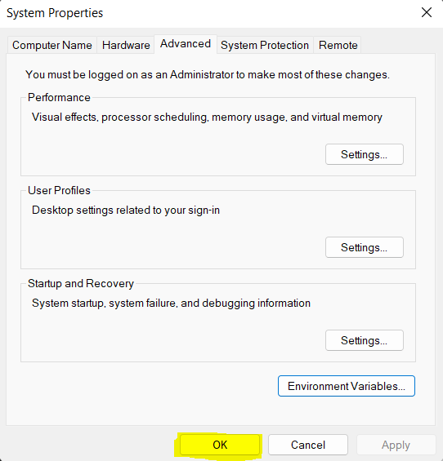
After adding path in User variable and system variable click on OK

